Slide 1
Intelligent Virtual Audience
Supervisor:
Dr. B. B. Amberkar
Project by:
Navroze Mishra

Slide 2
Abstract
Virtual reality is a new technology with great possibility to provide immersive experience to the users.
But very less serious use of the technology has been made to make full use of the technology.
Public speaking is one of the arts which comes to a person only after proper practice.
But public speaking cannot be practiced by a person alone.
We aim to create a virtual audience that simulates the actions of a real world audience, hence helping the user to practice public speaking.

Slide 3
Aim And Scope of the Project
The project aims to attain two major goals:
To create a virtual environment that responds to user inputs in simple ways as specified by the programmer
To make the responses generated by the virtual audiences more intelligent, that is, in resonance with the responses of the real world audiences.

Slide 4
Introduction to Virtual Reality
Technically, Virtual Reality (VR) is a three-dimensional, computer generated environment which an be explored and interacted with by a person with the help of proper gear.
The extent of virtual reality has continuously grown with time, from simple televisions in 1960’s to 3D technologies in the 2000’s to Head Mounted Devices (HMDs) in the present times.
VR has gone through significant breakthrough following the release of HMDs as normal smartphones can be used to simulate real life environments.
The definition of VR continues to grow and maybe in the future may involve other sensory inputs from the user.

Slide 5
Present Devices in VR
Head Mounted Devices (HMDs)
Facebook’s Oculus Rift
Microsoft HoloLens
Google Cardboard
Samsung Head Gear
Input Devices
Cyberith Virtualizer
OZO Camera
Leap Motion

Slide 6
Devices Used for the Project
Google Cardboard
Headgear
Lenses
Magnetic Trigger
Smartphone
Microphone
Accelerometer
Gyroscope

Slide 7
Phases of the Project
We categorized the project into four broad phases, two phases for each semester, as follows:
Modeling
Responsiveness
Resemblance
Intelligence

Slide 8
What has been done?

Slide 9
Modeling
The creation of the classroom model was done as follows:
Creating the animation objects for the classroom environment and the audience in Visual Studio.
Making animations for the classroom scene in the Unity interface.

Slide 10
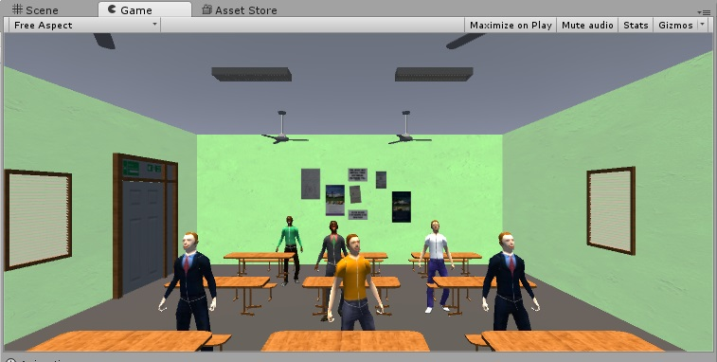
Modeling

Slide 11
Responsiveness
The audience in the present classroom scene presents response to 2 user inputs:
Body Movements
Captured via Gyroscope and Accelerometer in the smartphone
Voice
Captured via the Smartphone’s Microphone

Slide 12
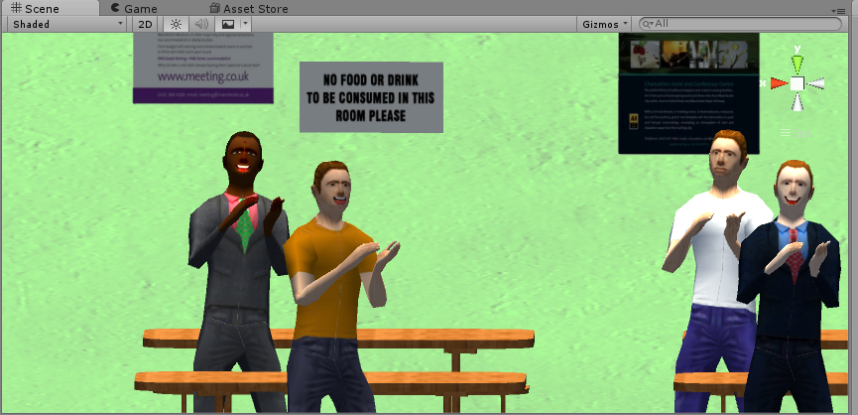
Responsiveness

Slide 13
Future Plans

Slide 14
Resemblance
This phase involves making the virtual audience response realistic as real world audience. It involves 2 steps:
Sample data from the real audience
Training of the virtual audience

Slide 15
Intelligence
Intelligence of the audience means audience should be able to analyze the user’s inputs and generate responses accordingly.
Speech Analysis
Ability to determine whether the speech is in context with the topic
Sentimental Analysis
Determine user’s expressions of fear or confidence through his speech

Slide 16
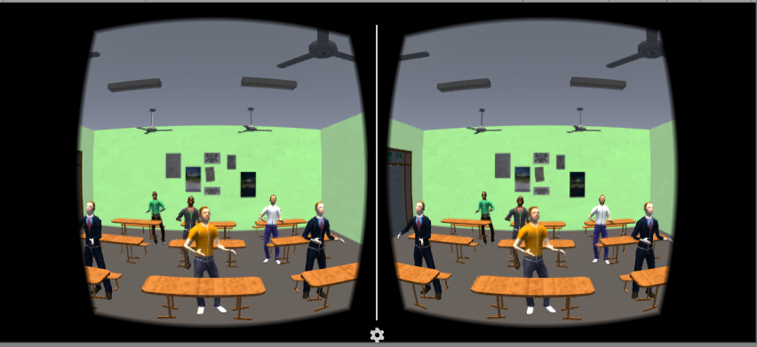
Demo

